Slide 1
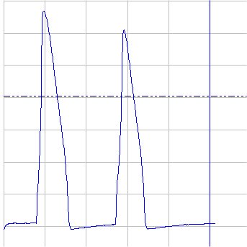
Salt Solns.
Patch Clamp Amplifier
Micro-
electrode
Drugs
Soln.
Outflow
Neuron
CA1
Brain Slice
CA3

